Slide 1

Trust Enhanced Path Routing
dratf-liu-trust-enhanced-path-routing-00
Xiang Liu, Yanchen Yan, Yu Zhang
PengCheng Laboratory, China
NASR side meeting @ IETF 119, Brisbane, March 2024

Slide 2
Content
Digital Trust and Trust level
Why do we need trust enhanced networking and path routing?
Design goals
Use cases
Call for collaborations

Slide 3
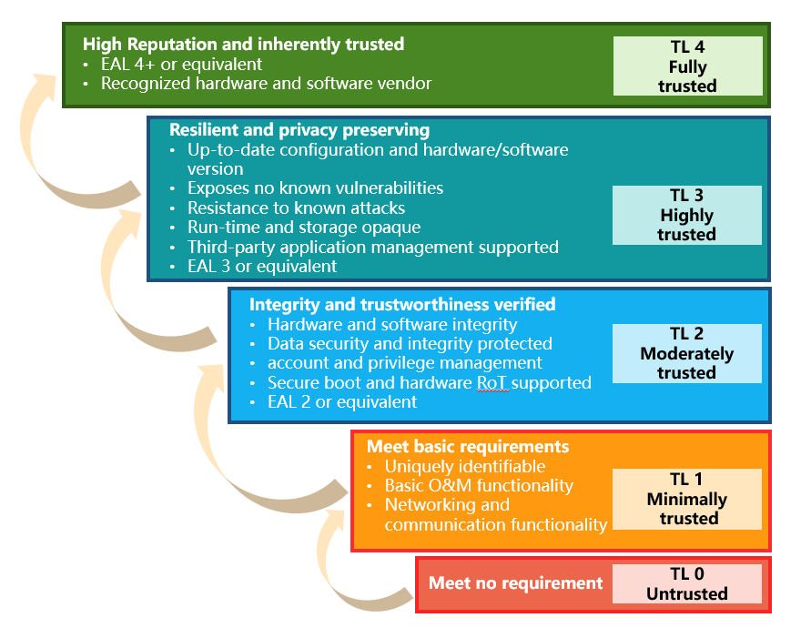
Digital trust and trust level
Trust: the measurable belief and/or confidence which represents accumulated value from history and the expecting value for the future [ITU-T T.3052].
Trust level: a form of trust evaluation, using several levels to represent trust values
three levels: low, medium, high [Ericsson ]
five levels: untrusted, minimally trusted, moderately trusted, highly trusted, fully trusted [ITU-T Y.trust-tla]

Slide 4
Why do we need trust enhanced path routing?
The trustworthiness crisis faced by Internet today
some mechanisms are proposed and discussed
our solution
routing attacks: prefix hijack, route injection, etc
unawareness and non-control of the transmission path
devices cannot be fully trusted: backdoors, malicious codes, store-and-decrypt
Also, some users want their sensitive data traversed only through devices trusted enough
Proof of transit
path-awareness and path validation
trusted path routing: simply separate the routers into two classes, trusted and untrusted
introduce the concept of trust level as a key attribute of network entities
can be measured, configured, exchanged
using trust level as routing/path calculation metric
users or services can select a path which satisfies their trust level requirement
users or services can verify trust level requirement are indeed satisfied: path validation techniques

Slide 5
Design goals
Measurable
Configurable
Verifiable
trust value of network entities/paths can be quantitatively measured, e.g., in forms of trust level
trust level evaluation metrics
trust level evaluation models: from node level to path level
mechanisms should be provided to enable trust configuration
control-plane & data-plane
intra-domain & inter-domain
the path data traversed can be verified
without modification/detour/…
path validation/PoT/…

Slide 6



Use Case: end-to-end path with different trust levels
traffic 1: moderately trusted
The trust level of a node depends on multi-facet factors
Trustworthiness attributes（AR4SI）
Supply chain
Vendor reputation
Third party certification
traffic 2: highly trusted
different traffics traversed different path with certain trust levels as required
the trust level of routers and path can be assessed and attested
the transmission path can be verified

Slide 7
Use Case: SFC with different trust level assurance
Consider two traffics which go through the SFCs that achieve same functionalities but with different trust assurance level
traffic 1
Service 1
Highly trusted
Service 2
Highly trusted
Service 3
Highly trusted
Service 1
moderately trusted
Service 2
moderately trusted
Service 3
moderately trusted
traffic 2
for different customers, services with different trust assurance levels can be selected
service providers can provide evidence to the customers that a chain of services with specified trust level is indeed provisioned

Slide 8
Looking for collaborations
discussion and draft writing
joint research on trust model, trust level evaluation, trust enhanced routing mechanism, etc.
protocol extensions, interface design, etc
Joint PoC implementation

Slide 9
Trust Enhanced Path Routing
dratf-liu-trust-enhanced-path-routing-00
Thank you! Questions?
Xiang Liu (PCL, China), liux15@pcl.ac.cn

